Slide 1
Optimization of Drip Irrigation Systems Using Kubernetes Managed Edge Computing
Tasnim Fuyara Chhoan (23366035)
Abrar Al Sayem (18201194)
Ripa Sarkar(23366009)
Asika Islam (22273013)
Mehnaz Ara Faizul (ST)
Humaion Kabir Mehedi (RA)
Team-21

Slide 2
Introduction
The introduction of precision agriculture has transformed the approach to farming, with drip irrigation systems leading the way in this revolution.This paper aims to explore the creation of a Kubernetes based framework designed to optimize distributed drip irrigation systems. The framework utilizes Kubernetes’ scalability and robustness to improve the efficiency of drip irrigation,contributing to sustainable agricultural practices. The paper will conduct a literature review, propose a theoretical framework and explore the potential impact and future directions of this innovative approach. Numerous studies have demonstrated the promising integration of Kubernetes in agricultural systems, offering a pathway to advance precision agriculture and address the challenges of contemporary agriculture.

Slide 3
LITERATURE REVIEW
Edge Computing in agriculture utilizes local processing in data sources,overcoming challenges posed by limited rural internet access. This approach, demonstrated in prototypical systems across various agricultural domains,enables real-time analytics and decision-making on Edge nodes. The agricultural industry has experienced a notable increase in the utilization of technologies like IoT, cloud computing,and artificial intelligence. Kubernetes has become a pivotal technology for overseeing distributed systems, especially in container orchestration explores the utilization of Kubernetes in high-performance computing systems, showcasing its effectiveness in orchestrating containerized applications. Kubernetes also focuses on advanced monitoring and management techniques for the clusters, particularly in the context of scientific computing and high-performance computing environments. This paper, introduces SLATE, a project aimed at accelerating collaborative scientific computing. It provides a secure container orchestration framework, particularly focusing on the Science DMZ to facilitate the creation of advanced multi-institution platforms and novel science gateways. This study proposes a new solution for automatic anomaly detection and alerting to aid system administrators in early detection and prevention of defects.

Slide 4
Collected data
To construct a viable solution for our study using Kubernetes managed edge computing, our research methodology used on a thorough analysis of existing literature and their key insights that align with our problem statement. The collected data spans a wide array of interrelated domains, including the technical intricacies of Kubernetes, the application of edge computing in agriculture, and the operational specifics of drip irrigation systems.
we examined Ferrández-Pastor et al. (2018) for an understanding of precision agriculture within the context of distributed computing architectures.
the IoT-based monitoring framework outlined by Abioye et al. (2021) was instrumental in shaping our understanding of real-time data acquisition from a network of distributed sensors.
Zhou et al. (2021) and Abdollahi Vayghan et al. (2018), which provided a comprehensive understanding of Kubernetes' resource management, scalability, and resilience.

Slide 5
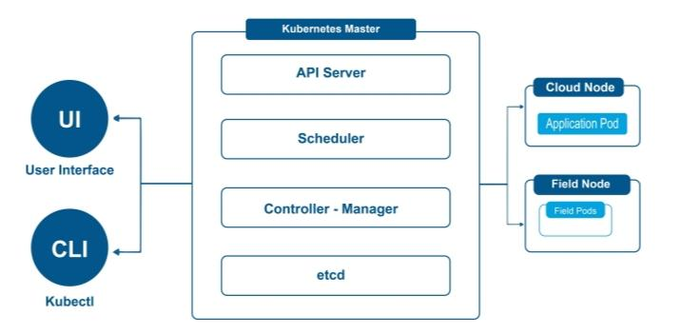
METHODOLOGY
This research focuses on developing a theoretical framework to incorporate Kubernetes into drip irrigation systems for advanced agriculture. Kubernetes an open-source platform designed to automate the deployment, scaling, and operation of application containers across clusters of hosts controlled by kubernetes Master. It is the control plane of a Kubernetes cluster, responsible for managing its state and configuration. It includes several components: the API,the etcd storage, the schedule, and the controller manager.

Slide 6
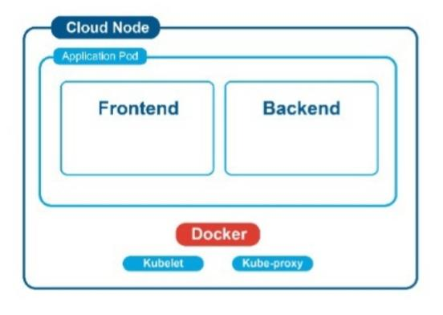
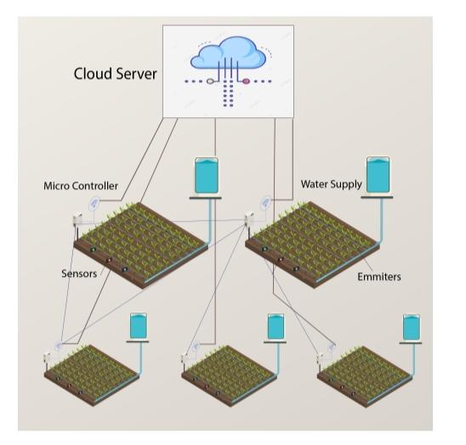
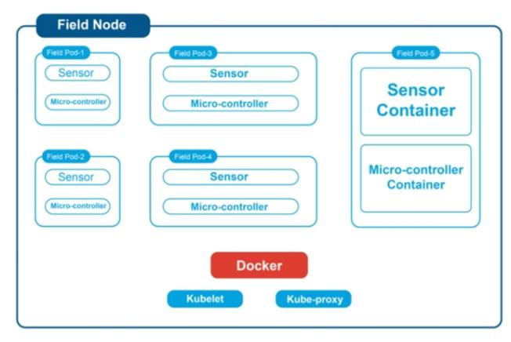
Kubernetes Managed Edge Computing for Irrigation
Cloud Node is the central hub of the Kubernetes-based system. They host application pods that include both frontend and backend components, crucial for the system’s operation and user interaction.Field Node is situated in the agricultural fields and con-sist of field pods equipped with various sensors and micro-controllers. In the node they are virtual representations of the group of IoT components.

Slide 7
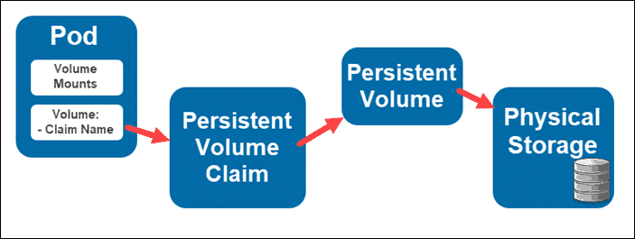
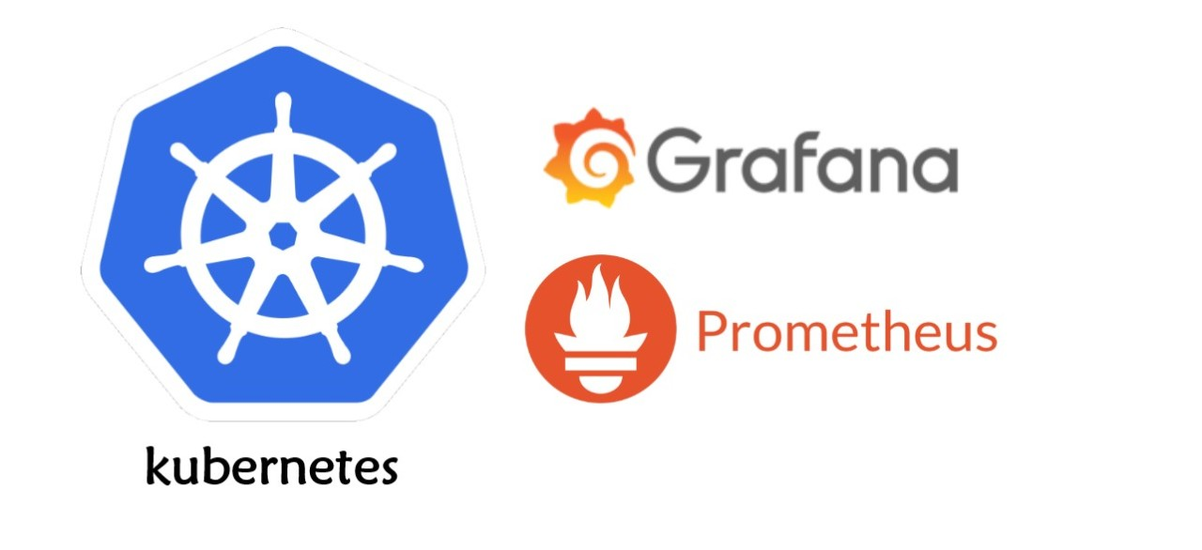
Data Storage and Prometheus
Data Flow
Persistent Volume
Prometheus
Grafana

Slide 8
Conclusion
The paper highlights the innovative use of Kubernetes in edge computing for enhancing drip irrigation systems in precision agriculture. It details how Kubernetes' architecture effectively manages distributed nodes for real-time data processing, offering better load balancing, self-healing, automated rollouts, and scalability compared to alternatives such as; Amazon ECS, Nomad etc. The system leverages Kubernetes pods for sensor data management and containerizes irrigation monitoring components, ensuring modularity and scalability. Key to this system are monitoring and computational analysis, with tools like Prometheus and Grafana used for real-time data visualization and alerting, enabling the system to respond to current conditions and predict future needs. However, challenges such as implementation complexity, high initial setup costs, and the need for technical expertise are significant. Additionally, broader adoption raises issues regarding cybersecurity, data privacy, and the need for fault-tolerant designs to adapt to the unpredictable agricultural environment.

Slide 9
THANK YOU

